Slide 1
Education 205X
The Impact of Social and Behavioral Science Research on Educational Issues:
Focus on English Language Learners and Issues of Policy and Practice
3/29/11

Slide 2
NERPPB
National Educational Research Policy and Priorities Board

Slide 3
NERPPB
National Educational Research Policy and Priorities Board
  Focus
  Quality
  Continuity

Slide 4
NERPPB
National Educational Research Policy and Priorities Board
  Focus
  Quality
  Continuity
Priorities Statements
Expert Panels (RAND)
Centers and Labs

Slide 5
NERPPB
National Educational Research Policy and Priorities Board
  Focus
  Quality
  Continuity
Phase I & II Standards
Standing Peer Review
Policy Statement

Slide 6
NERPPB
National Educational Research Policy and Priorities Board
  Focus
  Quality
  Continuity
Reauthorization
Assistant Secretary
Board
Partnerships
NRC
SERP
Center for Education

Slide 7
NERPPB Policy Statement
Recommendation 1: Designing research for credible results--Research in education should be conducted consistent with rigorous standards, reflecting scientific principles and appropriate designs for the matters being investigated. Congress and the Department should require annual state-of-research reports describing progress toward incorporation of rigorous research designs in all portfolios for OERI programs.

Slide 8
NERPPB Policy Statement
In its 1999 policy statement Board members recorded their view that the single criterion by which any scientific enterprise must be judged is the quality of its work. Scientific norms must be known and shared. The expectations for explicit hypotheses, sound designs, appropriate measures, sufficient data of good quality, and logical analyses must be widely shared. High standards must be insisted upon in all areas of a scientific agency’s work—in selection of proposals, design of appropriate methodologies, creation of research agendas, identification of effective and promising practices, and evaluation of all efforts it conducts or supports.

Slide 9
NERPPB Policy Statement
A 1999 conference at the Brookings Institution titled “Can We Make Education Policy on the Basis of Evidence?” examined the use of experimentation in education. The panelists argued that only experimental designs will yield sound answers to questions from educators, policymakers, and parents about how to improve the practice and results of education. Randomized assignment designs were referred to as the “gold standard” for developing believable results that will be accepted for action by policymakers because, the panelists asserted, there is little controversy over what the findings are when such designs are employed. Research in education was described by one panelist as dominated by faculty in schools of education and motivated by craft principles, not scientific principles. Panelists lamented a failure of Congress to insist on such gold standard evaluations of the education programs they are funding and claimed a lack of leadership in the Department of Education to insist on them.

Slide 10
NERPPB Policy Statement
A sharply contrasting perspective was expressed by Richard Murnane and Richard Nelson in a 1984 article in the journal of Economic Behavior and Organization titled “Production and Innovation When Techniques Are Tacit: The Case of Education.” Their argument was that effective teaching requires experimentation and problem solving activity every day. Moreover, they argued, while school authorities may provide the context in which teachers teach, they cannot control in any detail what a teacher does, either through monitoring or incentives. It is a mistake, the authors argue, to think of education R & D as like industrial or biomedical R & D. It should not be perceived as an expert-based activity that happens outside schools, or one to create “programs that work.” Instead, it should be part of the “problem solving, experimenting, evaluating, adapting to new contexts and goals, that is always going on in education.”

Slide 11
NERPPB Policy Statement
Such profound differences among scholars about concepts of what research in education is or should be cannot be resolved by legislative fiats but, instead, only through the questioning and responding and revising cycle of the field as it addresses real issues.
There is a need for vigorous explorations to find ways that experimental methodology can be reconciled with the Murnane and Nelson perspective, such as randomization at the classroom or school level, and to conceptualize and test other experimental or quasi-experimental methodologies that can strengthen findings about significant issues of lasting importance.

Slide 12
NERPPB Policy Statement
The power of science comes from a combination of strong theory and data that bear on the theory. This implies endorsement of explicit ideas and agreed-upon methods for exploring and testing these ideas based on observation that has internal and external consistency. Experiments, as a classification of research, should not be scattershot or universal. Rather, they should be justified by a cumulative record of rigorous naturalistic observation and piloting. This requires knowledge of context in addition to adherence to scientific canons. While experiments in education may not be used as frequently as they should as a preferred means for investigation—for a variety of reasons, perhaps, but availability of funds is surely one such reason—“science” should not be equated with “experiments.”

Slide 13
Carnine and Meeder Principles
Random assignment of students and teachers to conditions
Representative and unbiased sample
Minimum N=12 per condition
Valid, reliable measures
Confounding variables controlled
Valid statistics
Educationally significant

Slide 14
National Reading Panel Standards
True or quasi-experiment;
Study participants must be carefully described (age, demographic, cognitive, academic, and behavioral characteristics);
Study interventions must be described in sufficient detail to allow for replicability, including how long the interventions lasted and how long the effects lasted;
Study methods must allow judgments about how instruction fidelity was insured; and
Studies must include a full description of outcome measures.

Slide 15
Research Reform Proposal
A new, independent “Education Audit Agency”
Dedicated to the canons of scientific inquiry and the pursuit of truth, without fear or favor
In its conduct of education research, the Education Audit Agency should strive for scientific rigor, including, to the maximum degree possible, randomized field trials.
William Bennett, Chester Finn, Tom Loveless, Diane Ravitch
Seven Principles for Reauthorizing OERI, NAEP and NAGB
May 4, 2000

Slide 16
A Definition of Research
…is evaluated using randomized experiments
in which individuals, entities, programs, or activities
are randomly assigned to different variations
(including a control condition) to compare the
relative effects of the variations.
Amendment offered by Mr. Schaffer to the Amendment
in the nature of a substitute offered by Mr. Goodling (ESEA)
Document dated April 5, 2000, courtesy of Gerald Sroufe, AERA

Slide 17
NICHD Perspective
It must be concluded that too little education research conducted over the past century has been based on scientific principles… Indeed, much of the educational research conducted over the past 20 years has been predicated on the notion that scientific findings are relative--in the eyes of the beholder--and that science is not the process of discovering the ultimate truth of nature, but rather a social construction that changes over time. These types of anti-scientific ideologies and philosophical positions have been expressed within a culture of post-modern thinking where a major premise is that there is no genuine scientific method, but rather a sense that anything and everything goes.
Reid Lyon, Chief, Child Development and Behavior Branch, NICHD, Congressional Testimony
House Science Committee, Subcommittee on Basic Research, Oct. 26, 1999

Slide 18
NICHD Perspective
There appears to be a growing consensus that research carried out within the educational academic community should take place within a more rigorous context, be based on well developed scientific principles, should encourage the integration of multiple disciplines and methodologies, and incorporate an expert peer review system to assess the scientific quality of proposed research.
Reid Lyon, Chief, Child Development and Behavior Branch, NICHD, Congressional Testimony
House Science Committee, Subcommittee on Basic Research, Oct. 26, 1999

Slide 19
NICHD Perspective
Moreover, for educational research to realize its full potential, a sustained programmatic emphasis must be established to ensure continuity, the analysis of children’s learning and response to different forms of instruction over time and across settings, and to provide opportunities for replication.
Reid Lyon, Chief, Child Development and Behavior Branch, NICHD, Congressional Testimony
House Science Committee, Subcommittee on Basic Research, Oct. 26, 1999

Slide 20
NICHD Perspective
In addition, research training opportunities must be developed and improved in order to equip both researchers in training and education faculty members with a solid foundation in the inquiry skills that are necessary to address well defined gaps in the current knowledge base relevant to teaching and learning.
Reid Lyon, Chief, Child Development and Behavior Branch, NICHD, Congressional Testimony
House Science Committee, Subcommittee on Basic Research, Oct. 26, 1999

Slide 21
NICHD Perspective
In order to develop the most effective instructional approaches and interventions, we must clearly define what works, the conditions under which it works, and what may not be helpful. This requires a thoughtful integration of experimental, quasi-experimental and qualitative/descriptive methodologies. Education research can be strengthened by beginning to define an exact set of conditions--variables that can be quantified and
manipulated--and determine what happens in the presence and absence of these conditions. These observations, no doubt, must be enriched with qualitative insights that add ecological context to the quantitative scaffold. Education research must be open to taking the next step of formulating specific hypotheses that can be tested and confirmed or refuted.
Reid Lyon, Chief, Child Development and Behavior Branch, NICHD, Congressional Testimony
House Science Committee, Subcommittee on Basic Research, Oct. 26, 1999

Slide 22
Niches for RFT’s

Slide 23
Niches for RFT’s - OERI Phase II Standards
Sec. 701.21 What is the difference between an exemplary and a
promising program?
(a) In determining whether an educational program should be
recommended as exemplary or promising, the panel shall consider--
(1) Whether, based on empirical data, the program is effective and
should be designated as exemplary; or
(2) Whether there is sufficient evidence to demonstrate that the
program shows promise for improving student achievement and should be
designated as promising.
(b) The Secretary relies upon the judgment and expertise of peer
reviewers, as established in Sec. 701.11, to determine the nature and
extent of evidence required to distinguish between promising and
exemplary programs and to apply the four criteria established in
Sec. 701.22, and their own individual factors under each criterion in
making this determination.
Sec. 701.22 What criteria are used to evaluate programs for exemplary
or promising designation?
The Secretary establishes the following evaluation criteria for
expert panels to use in determining whether an educational program
should be recommended as exemplary, promising, or neither:
(a) Evidence of success.
(b) Quality of the program.
(c) Educational significance.
(d) Replicability.

Slide 24
Niches for RFT’s
Problem-Solving Research and Development (National Academy of Education)
All the participants share in a commitment to and accountability for multiple outcomes of the work:
• tangible improvement of a complex educational system, responsive to the circumstances of that system’s functioning and according to documentable criteria
• development of materials, personnel, and other resources to support transport of the aims, operational concepts, and methods that are developed in the project to other sites in which people want to adopt those aims, concepts, and methods (“travel”)
• contributions to the research literature that documents the results of these efforts and provides the forum in which alternative explanatory principles are developed, evaluated, and clarified, so that the results of these projects will cumulatively advance society’s understanding of general principles of educational practices and processes.

Slide 25
Niches for RFT’s
“You can't be a little bit random.”
Judy Gueron, Brookings Forum

Slide 26
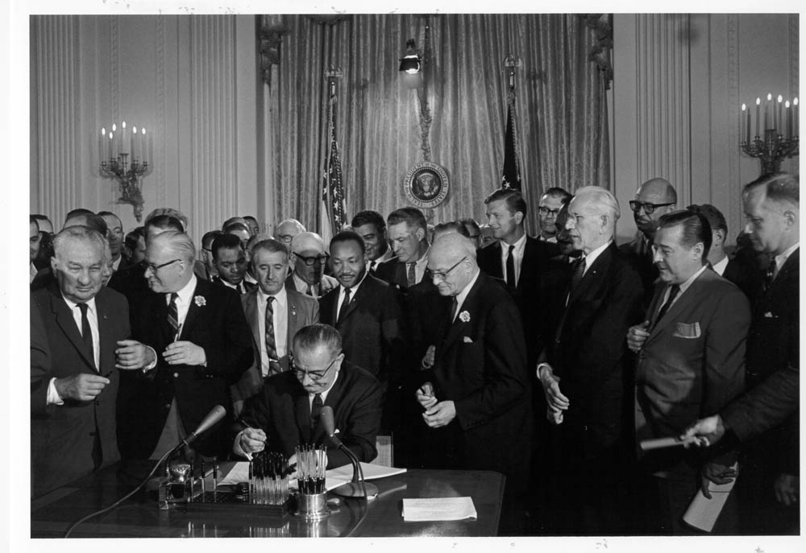
Civil Rights Act of 1964

Slide 27




Policy and Practice:
Carrots and Sticks
Civil Rights Act, Lau v. Nichols, EEOA, Castañeda interpretation.
Elementary and Secondary Education Act Title I, Title III…
Notes:
27

Slide 28

Castañeda v. Pickard (1981)
Fifth Circuit Court of Appeals
§ 1703(f) of the EEOA makes it unlawful for an educational agency to fail to take "appropriate action” to overcome language barriers that impede equal participation by its students in its instructional programs."
(1) Whether the school system is pursuing a program informed by an educational theory recognized as sound by some experts in the field, or, at least, deemed a legitimate experimental strategy.
(2) Whether the programs and practices actually used by the school system are reasonably calculated to implement effectively the educational theory adopted by the school.
(3) Whether the school's program succeeds, after a legitimate trial, to produce results indicating that the language barriers confronting students are actually being overcome.
Judge Carolyn Randall (King)
648 F.2d 989; 1981 U.S.
Notes:
28

Slide 29
Castañeda v. Pickard (1981)
Fifth Circuit Court of Appeals
§ 1703(f) of the EEOA makes it unlawful for an educational agency to fail to take "appropriate action” to overcome language barriers that impede equal participation by its students in its instructional programs."
(1) Whether the school system is pursuing a program informed by an educational theory recognized as sound by some experts in the field, or, at least, deemed a legitimate experimental strategy.
(2) Whether the programs and practices actually used by the school system are reasonably calculated to implement effectively the educational theory adopted by the school.
(3) Whether the school's program succeeds, after a legitimate trial, to produce results indicating that the language barriers confronting students are actually being overcome.
648 F.2d 989; 1981 U.S.
Notes:
29

Slide 30
Castañeda v. Pickard (1981)
Fifth Circuit Court of Appeals
§ 1703(f) of the EEOA makes it unlawful for an educational agency to fail to take "appropriate action” to overcome language barriers that impede equal participation by its students in its instructional programs."
(1) Whether the school system is pursuing a program informed by an educational theory recognized as sound by some experts in the field, or, at least, deemed a legitimate experimental strategy.
(2) Whether the programs and practices actually used by the school system are reasonably calculated to implement effectively the educational theory adopted by the school.
(3) Whether the school's program succeeds, after a legitimate trial, to produce results indicating that the language barriers confronting students are actually being overcome.
648 F.2d 989; 1981 U.S.
Notes:
30

Slide 31
Castañeda v. Pickard (1981)
Fifth Circuit Court of Appeals
§ 1703(f) of the EEOA makes it unlawful for an educational agency to fail to take "appropriate action” to overcome language barriers that impede equal participation by its students in its instructional programs."
(1) Whether the school system is pursuing a program informed by an educational theory recognized as sound by some experts in the field, or, at least, deemed a legitimate experimental strategy.
(2) Whether the programs and practices actually used by the school system are reasonably calculated to implement effectively the educational theory adopted by the school.
(3) Whether the school's program succeeds, after a legitimate trial, to produce results indicating that the language barriers confronting students are actually being overcome.
648 F.2d 989; 1981 U.S.
Notes:
31

Slide 32
Sound theory
revise
examine
Results
reform
Implementation
evaluate
Articulated in OCR policy memoranda issued on Sept. 11, 1984, reiterated successively in 1985, 1990, 1991.
Notes:
This is not rocket science, but give us a framework as we think about what is a good district or school practice.
It is important to note that this framework needs to apply to both the English language acquisition needs of the students, and to the academic content needs of the students. Both are clearly articulated in Lau, as well as most recently in NCLB.
32

Slide 33


WordSift: http://WordSift.com

Slide 34
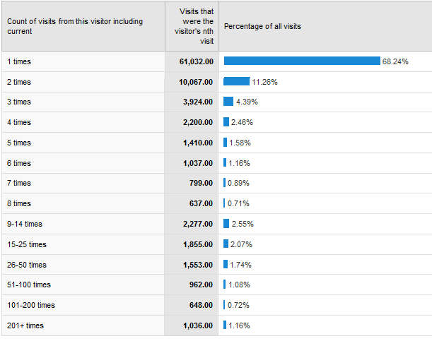
Past Year Analytics

Slide 35
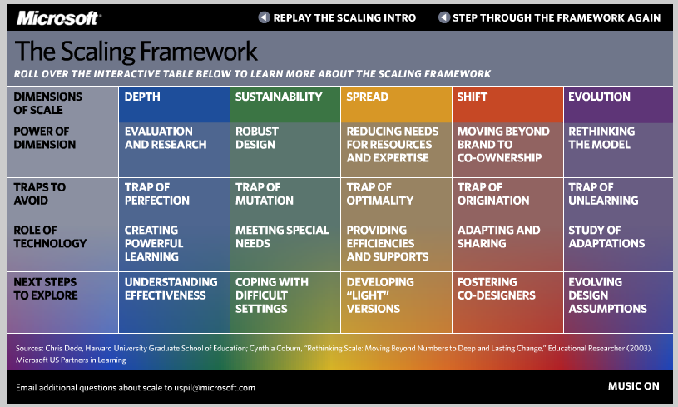
http://www.microsoft.com/education/demos/scale/

Slide 36

http://publicschoolchoice.lausd.net/

